Slide 1
Machine Learning Henry Harvin(Course) : Credit risk Modelling
By Sharon Christina
Supervised by Mr. Anil Jadon

Slide 2
Overview
Introduction
Objectives
Data
Methodology
Exploratory Data Analysis
Descriptives
Outlier Detection and Winsorisation
Multi-Collinearity
Logistic Regression
Method Validation
Confusion Matrix and parameters
ROC Curve/ AUC Score
Real Test Data
Conclusion
References & Source Code

Slide 3
Introduction
Credit-Risk Modelling
Credit risk : Risk to the lender associated with loan/credit default by a borrower
Models that arrive at a probability of loan/interest payment default by the borrower (Red Arrow in given figure)
Rationale behind the study?
Lender to arrive at a decision whether to give a loan to a person given a set of personal statistics (variables) (Green arrow in given figure)
Lender
Lends Principal
Borrower
Loan received
Borrower
Pays Interest
Lender
Receives Income

Slide 4
Objectives
To develop a credit risk model to assess the ability of a person to repay or default on loans using logistic regression
To use the credit risk model to predict the ability of a person to repay or default on loans using logistic regression

Slide 5
Exploratory Data Analysis
Variables of Interest
Variable Name | Description | Type
TARGET VARIABLE
SeriousDlqin2yrs | Person experienced 90 days past due delinquency or worse | Y/N
EXPLANATORY VARIABLES
RevolvingUtilizationOfUnsecuredLines | Total balance on credit cards and personal lines of credit except real estate and no installment debt like car loans divided by the sum of credit limits | percentage
age | Age of borrower in years | integer
NumberOfTime30-59DaysPastDueNotWorse | Number of times borrower has been 30-59 days past due but no worse in the last 2 years. | integer
DebtRatio | Monthly debt payments, alimony,living costs divided by monthy gross income | percentage
MonthlyIncome | Monthly income | real
NumberOfOpenCreditLinesAndLoans | Number of Open loans (installment like car loan or mortgage) and Lines of credit (e.g. credit cards) | integer
NumberOfTimes90DaysLate | Number of times borrower has been 90 days or more past due. | integer
NumberRealEstateLoansOrLines | Number of mortgage and real estate loans including home equity lines of credit | integer
NumberOfTime60-89DaysPastDueNotWorse | Number of times borrower has been 60-89 days past due but no worse in the last 2 years. | integer
NumberOfDependents | Number of dependents in family excluding themselves (spouse, children etc.) | integer

Slide 6
Data Descriptives
 | BORROWING CAPACITY | AGE | DUE 30-59 DAYS | DEBT/INCOME RATIO | INCOME (PM) | OPEN LINES | DUE 90 DAYS | REAL ESTATE LOANS | DUE 60-89 DAYS | DEPENDENTS
COUNT | 150000.00 | 150000.00 | 150000.00 | 150000.00 | 120269.00 | 150000.00 | 150000.00 | 150000.00 | 150000.00 | 146076.00
MEAN | 6.048438 | 52.295207 | 0.421033 | 353.005076 | 6670.22 | 8.452760 | 0.265973 | 1.02 | 0.24 | 0.76
MEDIAN | 0.15 | 52.00 | 0.00 | 0.37 | 5400.00 | 8.00 | 0.00 | 1.00 | 0.00 | 0.00
MODE | 0.00 | 49.00 | 0.00 | 0.00 | 5000.00 | 6.00 | 0.00 | 0.00 | 0.00 | 0.00
SKEWNESS | 97.63 | 0.19 | 22.60 | 95.16 | 114.04 | 1.22 | 23.09 | 3.48 | 23.33 | 1.59
KURTOSIS | 14544.71 | -0.49 | 522.38 | 13734.29 | 19504.71 | 3.09 | 537.74 | 60.48 | 545.68 | 3.00
STANDARD DEVAITION | 249.76 | 14.77 | 4.19 | 2037.82 | 14384.67 | 5.15 | 4.17 | 1.13 | 4.16 | 1.12
MINIMUM | 0.00 | 0.00 | 0.00 | 0.00 | 0.00 | 0.00 | 0.00 | 0.00 | 0.00 | 0.00
25% | 0.03 | 41.00 | 0.00 | 0.18 | 3400.00 | 5.00 | 0.00 | 0.00 | 0.00 | 0.00
50% | 0.15 | 52.00 | 0.00 | 0.37 | 5400.00 | 8.00 | 0.00 | 1.00 | 0.00 | 0.00
75% | 0.56 | 63.00 | 0.00 | 0.87 | 8249.00 | 11.00 | 0.00 | 2.00 | 0.00 | 1.00
MAXIMUM | 50708.00 | 109.00 | 98.00 | 329664.00 | 3008750.00 | 58.00 | 98.00 | 54.00 | 98.00 | 20.00

Slide 7
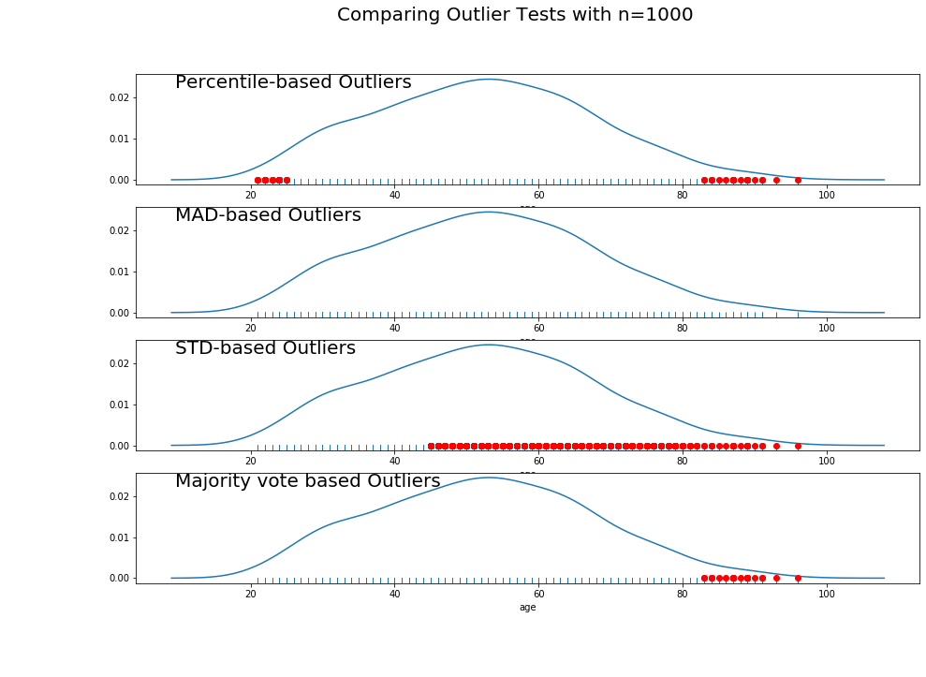
OUTLIER METHODS (PERFORMED ONLY ON TRAINING.AGE)
Outlier detection for a sample of 1000 using other methods.
Given are different methods of outlier detection
Majority vote based (MVB) – combines all three types i.e Percentile based, Median absolute deviation based (MAD) and STD based.
MVB : For a data point to be considered an outlier. It must pass two test out of the three tests performed.

Slide 8
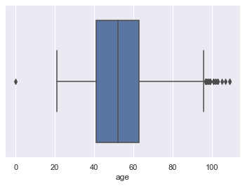
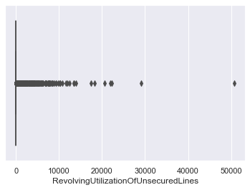
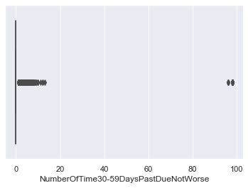
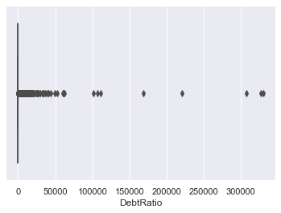
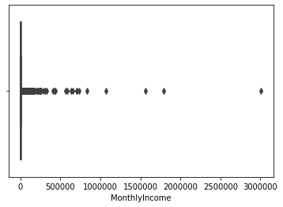
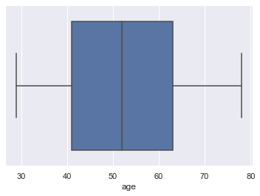
Treating Outliers using Winsorisation
Before and after Winsorization - Age
Almost all the variables had some outliers, I have shown a few of them above. Thus, winsorisation of the data was carried out.
One sample using ‘age’ is given in the slide.
Winsorisation doesn't eliminate outliers but includes them after replacing extreme values with max or min values of data.

Slide 9
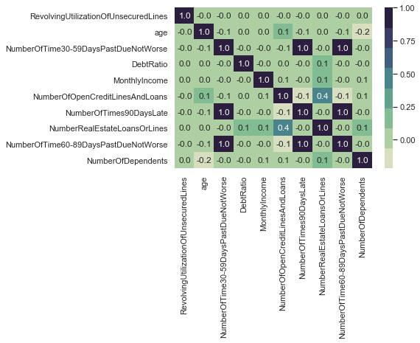
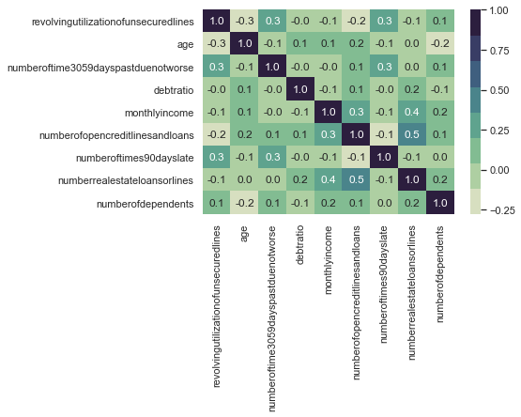

Correlation Table of all the variables in the data frame used in the analysis, there is prefect correlation observed in areas other than the diagonal, this indicative of multicollinearity. Thus, we perform VIF test to confirm the same.
Correlation Table after treating for multi-collinearity (drop 60day due_training2)
Variable Name | Variance Inflation Factor
DATASET → | Full | Training1 | Training2 | Training3
TARGET VARIABLE
SeriousDlqin2yrs | 1.06 | 1.21 | 1.22 | 1.18
EXPLANATORY VARIABLES
RevolvingUtilizationOfUnsecuredLines | 1.00 | 1.24 | 1.26 | 1.24
age | 1.10 | 1.16 | 1.16 | 1.16
NumberOfTime30-59DaysPastDueNotWorse | 41.57 | DROPPED | 1.18 | 1.21
DebtRatio | 1.02 | 1.06 | 1.06 | 1.05
MonthlyIncome | 1.02 | 1.02 | 1.02 | 1.02
NumberOfOpenCreditLinesAndLoans | 1.29 | 1.31 | 1.33 | 1.32
NumberOfTimes90DaysLate | 73.85 | 1.25 | 1.23 | DROPPED
NumberRealEstateLoansOrLines | 1.27 | 1.34 | 1.34 | 1.34
NumberOfTime60-89DaysPastDueNotWorse | 93.85 | 1.16 | DROPPED | 1.17
NumberOfDependents | 1.08 | 1.12 | 1.11 | 1.12
MULTI-COLLINEARITY IN DATA and HANDLING MULTICOLLINEARITY

Slide 10
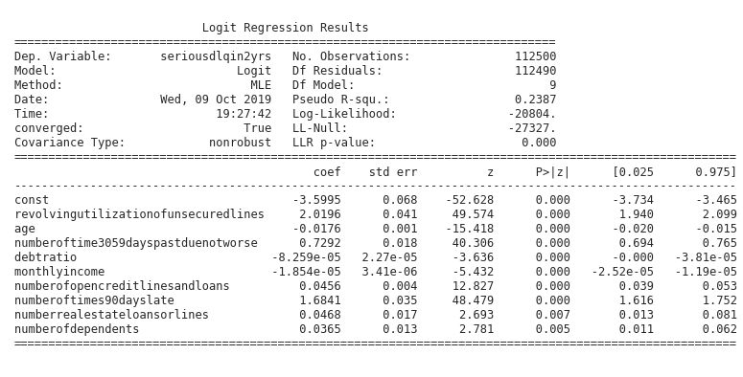
Logistic Regression
Pseudo R square seems low, indicates poor model fit.
However, p value indicates that all variables are having a significant impact on target (seriousdlqin2yrs)

Slide 11
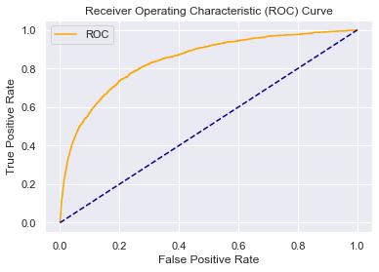
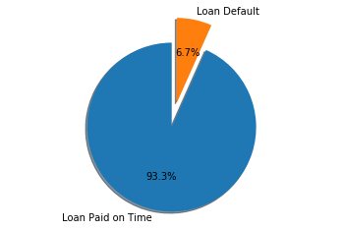
Logistic Regression (Model Validation)
AUC Score = 0.84
Misclassification Rate = 6.49%
Based on ROC Curve and area under ROC = 0.84, we find that the model is good. And can classify default loans and good loans
Confusion Matrix | Predicted Yes | Predicted No
Actual Yes | 34621 (TP) | 324 (FN)
Actual No | 2134 (FP) | 421 (TN)
Accuracy (TP+TN/ Total) = 93.45%
Sensitivity (TP/ Actual Yes) = 99.01%
Specificity (TN/ Actual NO)= 85.07%
A representation of ‘those who default’ relative to ‘those who do not’ in the sample data set given.

Slide 12
Results - Summary
Objective 1 : To develop a credit risk model to assess the ability of a person to repay or default on loans using logistic regression
Developed a model and performed validation on the same. Though the model fit is questionable, the explanatory variables are highly significant.
Objective 2: To use the credit risk model to predict the ability of a person to repay or default on loans using logistic regression
This was done by using train and test data on initial data given. The model was validated using Confusion Matrix, ROC curve.
Finally, out of sample test data was used to predict results. This is stored as an output in a CSV file.

Slide 13
References
Websites used:
https://stackoverflow.com
https://www.wikipedia.org
https://github.com/akjadon
https://www.geeksforgeeks.org
https://www.dataschool.io/simple-guide-to-confusion-matrix-terminology/
Other websites for statistical keywords etc.
Code Used:
Input Files:
Output Files

